Slide 1


Planetary Radio Interferometry and Doppler Experiment (PRIDE):
Scintillation of VEX and MEX radio signal on interplanetary and ionosphere plasma
G. Molera Calvés ^{1,2} e-mail: molera@jive.nl
On behalf of the PRIDE team
¹ Joint Institute for VLBI in Europe, the Netherlands
² Aalto University Metsähovi radio observatory, Finland
Notes:
I’m here to present a slightly different use that our group is doing with the EVN radio telescopes. Our group, PRIDE main target are primarily any phenomena that occur here in our Solar System.

Slide 2
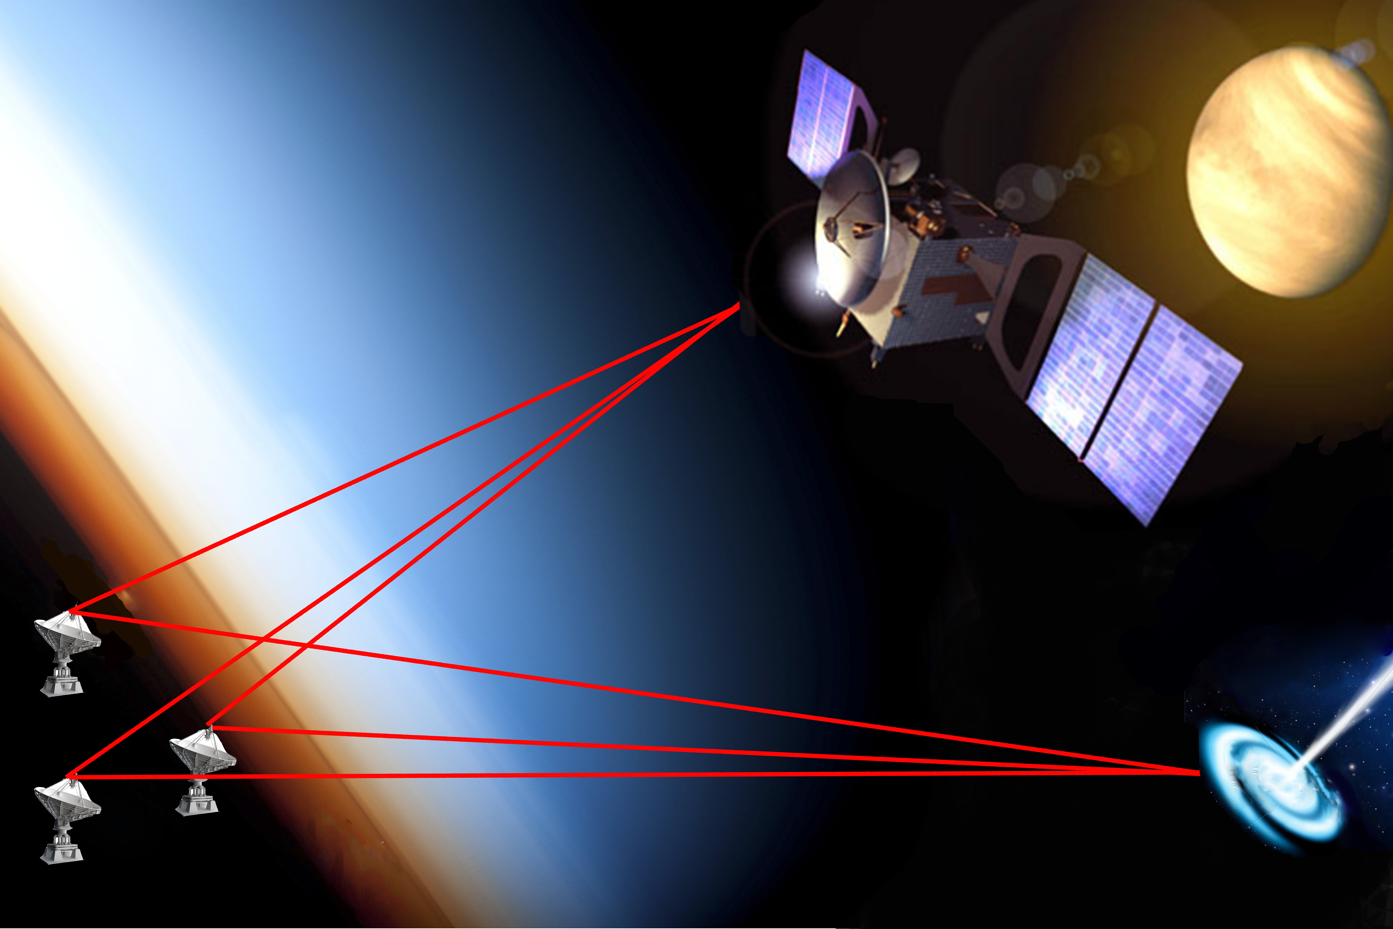
Planetary Radio Interferometry and Doppler Experiment (PRIDE)
Celestial body
target
VLBI network and 2-way tracking stations
Spacecraft
Background
sources
Notes:
PRIDE is a generic experimental setup of on-board and Earth-based radio devices and facilities, with the goal of providing precise estimates of spacecraft states vectors. This is done by performing precise Doppler tracking of the spacecraft carrier signal and VLBI-style observations in phase referencing mode (tracking alternating between the spacecraft ‘s signal and a background natural source).

Slide 3
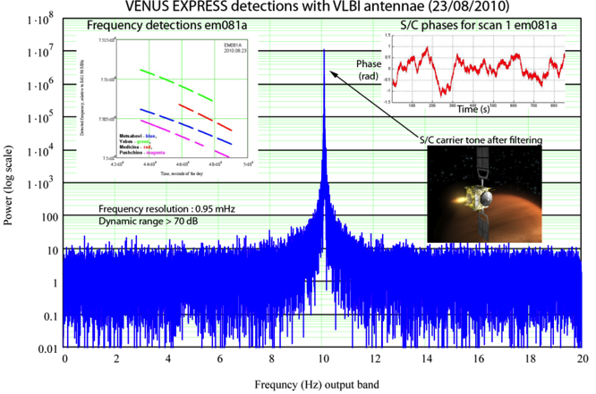
Block-diagram of data processing and analysis
Raw observational data
Reference Source
coordinates
A priori state
vectors of the S/C
Broad-band correlation
of the quasar with the far-field delay model
Broad-band correlation
of the S/C data band with
the near-field delay model
Narrow-band correlation of the S/C carrier and ranging tones with the near-field delay model
Residual group delay
and phase
Residual group delay
and phase
Residual phases of the carrier and ranging tones
Delay/phase corrections
Group and phase delay of the S/C signal
with resolved 2π ambiguity
Reconstruction of the apparent state vectors of the S/C
Notes:
The end product of this processing pipeline are lateral position and radial velocity estimates. The accuracy of these estimates depend on a number of parameters, of which the most important are the stability of the on-board oscillator and the carrier signal power.

Slide 4
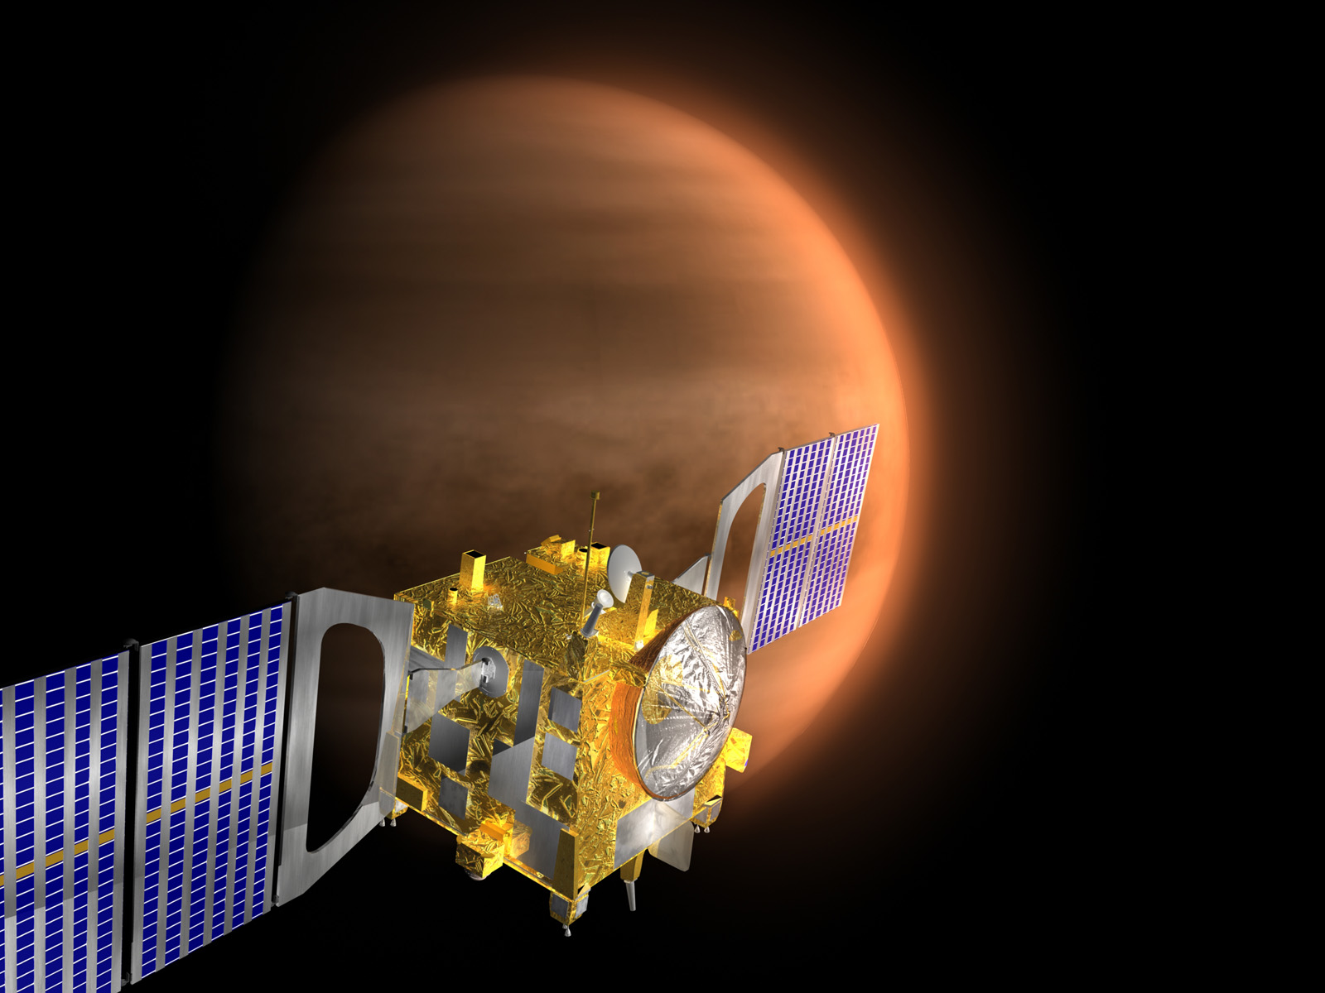
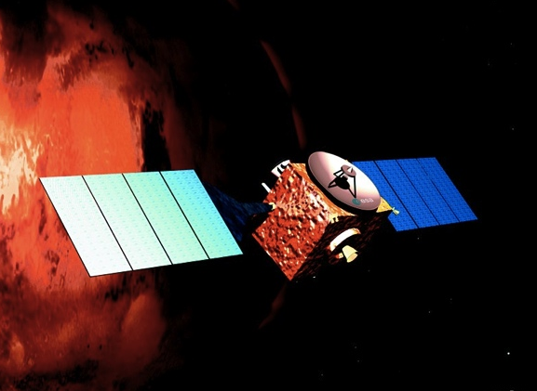
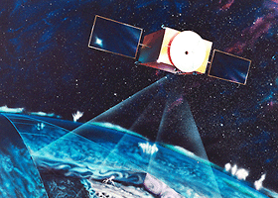
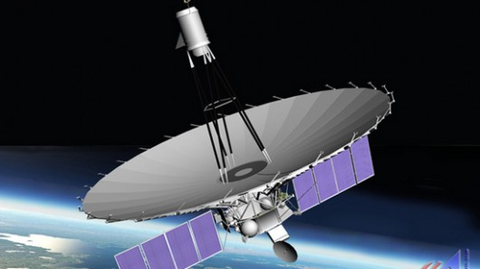
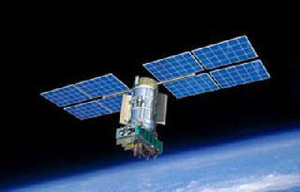
Our targets
Current PRIDE missions
ESA Venus Express (VEX)
ESA Mars Express (MEX)
GLONASS satellites
Radio Astron Space VLBI
GAIA telescope
Prospective PRIDE missions
ESA-JAXA Bepicolombo 2015
ESA ExoMars 2016
ESA MarcoPolo-R 2020
RSA Venera-D 2024
ESA Jupiter Icy Europa (JUICE)
Notes:
Bepicolombo: joint mission targetting Mercury to be launched in 2015. 2 orbiters and interesting for fly-bys and other RS experiments.
Venera-D: Russian proposed mission to be launched in 2016 to conduct radar remote-sensing observations of Venus. Mission will include a lander and a orbiter.
Exomars: A rover to be delivered to Mars in 2018.
JUICE: A spacecraft to study the moons of Jupiters. The next big mission commossioned by ESA.
MarcoPolo-R: study and return sample from a near-by asteroid. The mission is in commition stage for being launched in 2020-22…
GAIA: optical telescope to be launched in 2013. Need of high accuracte estimate of the position of spacecraft in its location at point Lagrange L1.

Slide 5
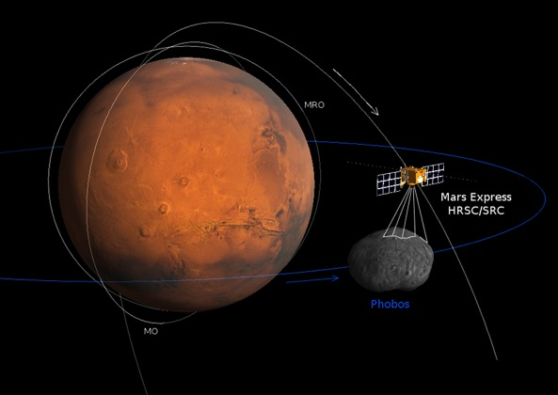
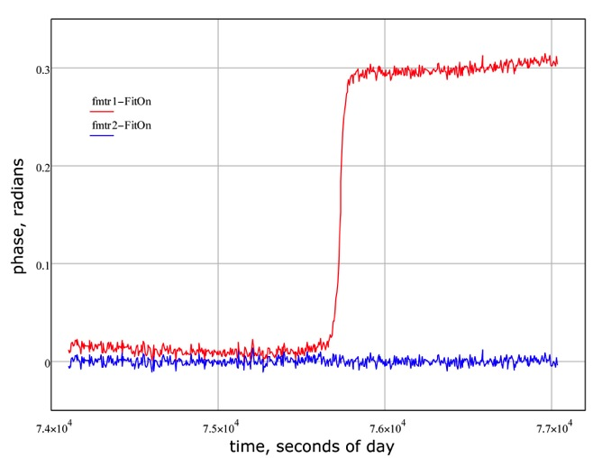
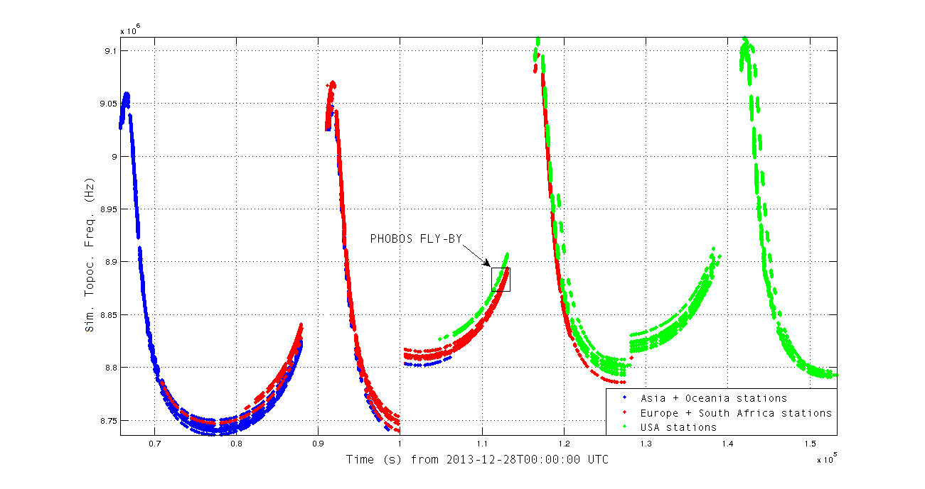
2.1 Phobos fly-by: MEX tracking
MEX approached Phobos at only 58 km on Dec 29, 2013.
31 stations tracked for 24 hours 3 orbits at Mars.
Combined Australian/Asiatic + EVN + VLBA
Precise reconstruction of MEX orbital perturbations is currently in process.
The gravity coefficient C_{2,0} will be determined by a least square fit of spacecraft dynamical model to the PRIDE tracking data.
Credit: ESA/DLR/FU Berlin (G. Neukum).
Phobos gravity off
Phobos gravity on
Notes:
31 stations around the globe tracked continuously 3 revolutions around Mars.
MEX approached Phobos at only 58 km on December 29, 2013.
Precise reconstruction of MEX orbital perturbations is currently in process.
Using a least square fit of spacecraft dynamical model to the PRIDE tracking data will determine the gravity coefficient C_{2,0}.

Slide 6
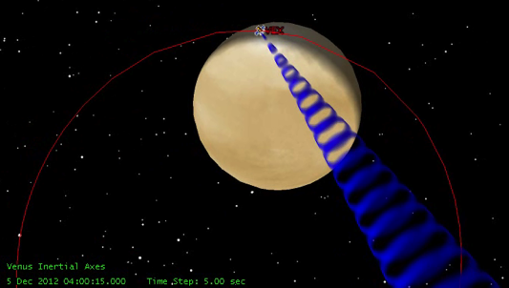
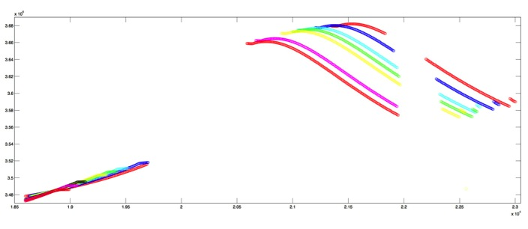
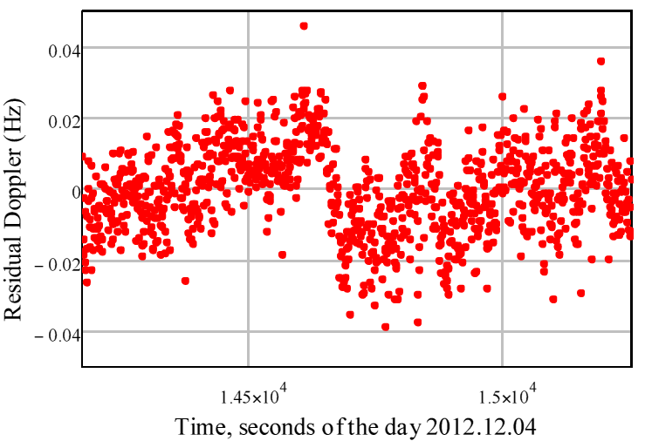
2.2 VEX atmospheric drag campaign
VEX was lowered to enter the atmosphere of Venus.
12 radio telescopes participated in the Venus Express Atmospheric Drag Experiment (VExADE) (Dec 2012, May 2013 & June 2014).
The atmospheric drag was at a level of 40 mHz in Doppler frequency or 1.5 mm/s velocity reduction.
Day 12
Day 1
Notes:
We conducted two runs of several observations. December 2012 and May 2013. In both cases, VEX orbit was lowered to 175 km in order to probe and investigate the upper atmosphere of Venus. We used more than 12 radio telescopes to track VEX. Sessions were scheduled every day. We used at least 3 radio telescopes per each epoch.
Post-processing showed the detection of the atmospheric drag at a level of 40 mHz in Doppler frequency or 1.5 mm/s of velocity reduction.

Slide 7
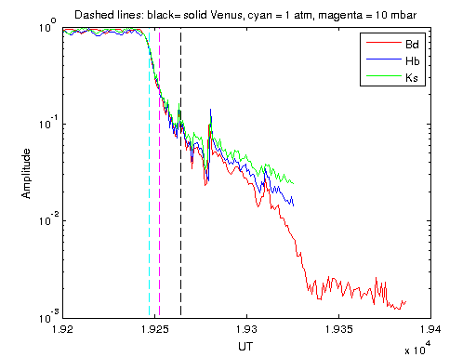
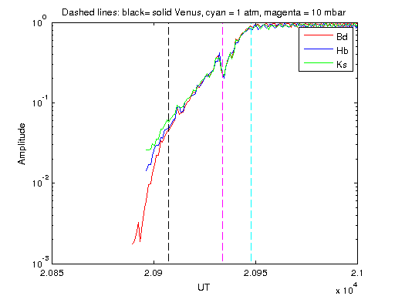
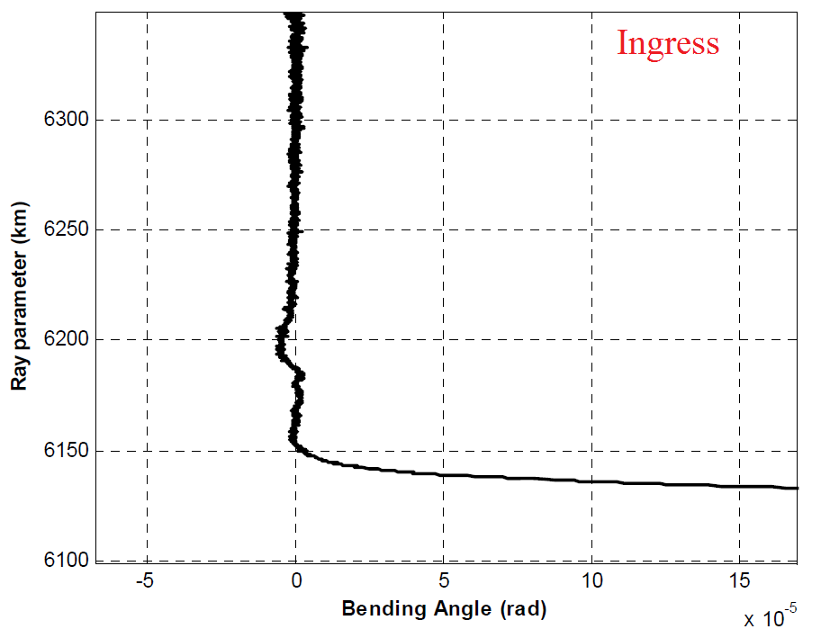
2.3 Radio occultation with VEX and MEX
VLBI Doppler is also suitable for radio occultation, due to its sensitivity to signal path deviations perpendicular to the line of sight.
Several experiments have been conducted in parallel to Phobos fly-by or drag campaign experiments.
  VEX 3-telescopes March 2014 (Bd,Sv,Zc).
  MEX (S/X)-band with Wk on 05/06 2014.
T. Bocanegra (TU Delft) is working on the code to process the data.
Notes:
Magenta = 1 atm
Cyan = 10 mbar

Slide 8
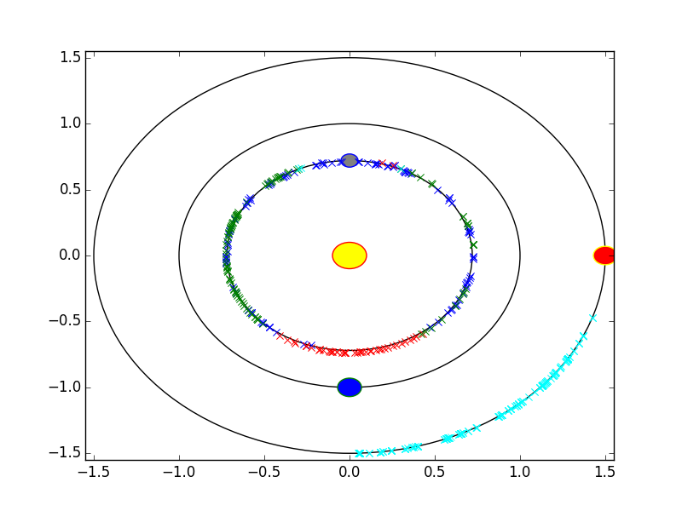
3. Interplanetary scintillation study
Phase scintillation of VEX telemetry signal has been observed with EVN telescopes since 2009.
5 years of observations – 340 observations
Currently up to 5 sessions per week (Many thanks to Ht, Kvazar, Ww, Mh, W)
Phase fluctuations of the carrier line are used to characterize the IPS fluctuations.
(Molera Calves, A&A, 2014; Molera Calves, PSS, 2014)
Notes:
The average slope (m) was equal to -2.42 with a standard deviation of 0.25.
The density fluctuations at different time scales are used to determine the influence of the Solar wind fluctuations on the accuracy of the astrometric VLBI observations of planetary probes.
A Total Electron Content (TEC) model was derived from the phase fluctuations density as a function of the solar elongation.

Slide 9
Analysis results for VEX
(Molera Calves, A&A, 2014; Molera Calves, PSS, 2014)
Notes:
This study of phase fluctuation dependence on the Solar elongation is providing the estimates of the optimal nodding time scheme for EVN phase referencing and different Solar elongations and phase of the Solar activity cycle to achieve the better imaging and position results.
First results were published (Molera et al., 2014 A&A)
Second paper is submitted at PSS (Molera et al., 2014 b, PSS)
Results on minor conjunction are in preparation.

Slide 10
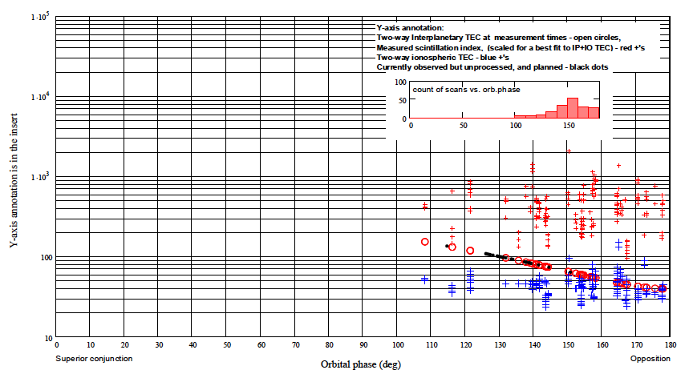
Analysis results for MEX

Slide 11
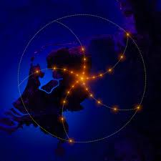
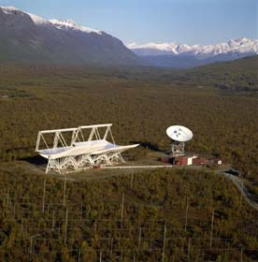
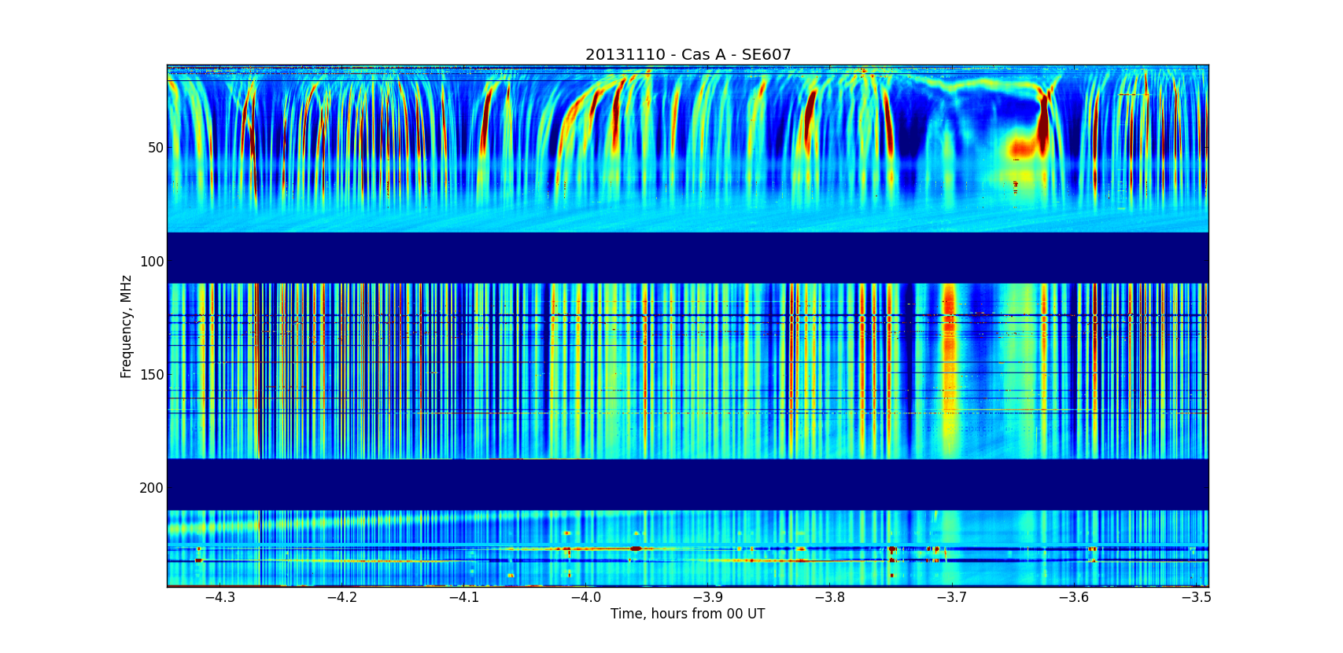
3.1 IPS with EVN and LOFAR combined observations
Classical IPS studies have used the amplitude fluctuations from the flux density emitted by bright sources to determine the scintillation index.
Combined effort of EISCAT + LOFAR + VLBI for discerning the origin of scintillation.
16.06.14 Cassopeia A was angularly close to VEX.
Station: Zc, Sv, Ys, Wz, Ht, On
Notes:
example dynamic spectrum from an observation of Cassiopeia A taken using the LOFAR station at Onsala, Sweden, in November 2013. The data were normalised by dividing each frequency channel by its median; hence the colour scale runs from 0.9 to 1.2.
illustrates the geometry of observational set-up, with the longest East-West baseline Ys-Zc observing VEX at X-band at finite distance and LOFAR observing CTA21 at ~100 MHz at infinity. Different Fresnel scales at these two frequencies (~1000 km for LOFAR and ~100 km for EVN) allow different spatial and temporal scales of moving inhomogenities in the solar wind plasma to be probed.

Slide 12
Summary
PRIDE team has demonstrated the accuracy of the VLBI phase-referencing method for tracking spacecraft in a number of occasions (VEX and Radio Astron).
PRIDE is a “free” contribution to any space mission
Current ongoing research focuses on :
  Characterize the atmospheric and ionospheric structure of planets and interplanetary media.
  Phobos fly-by tracking, Venus drag campaign and radio occultation
  Orbit determination of radio astron.
ESA’s JUICE mission includes PRIDE in their scientific package.
Tracking observations of VEX and MEX will continue in order to improve our scintillation measurements

